Slide 1

Engaging with Customer using Data-Driven Insights
TEAM
17
Ziyang Guo, Sean Lee, Vakula Mallapally, Bill Szeto, Tianhua Zhu
Notes:
Speaker 1: Vakula
Hello. We are group 17. I’m Ziyang Guo. I’m Sean Lee. I’m Vakula Mallapally. I’m Bill Szeto. I’m Tianhua Zhu.
Our project is to look at how to engage customers using data-driven insights.

Slide 2
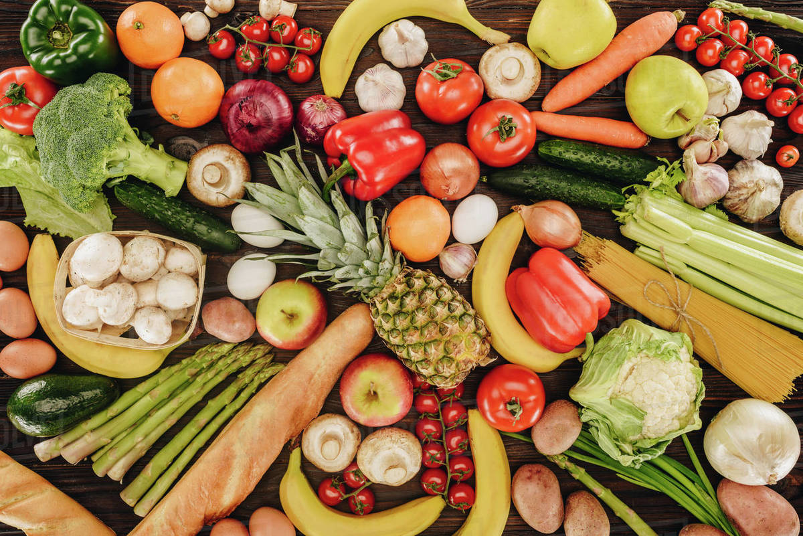
Business Problem
A food company seeks to improve customer engagement
How can the company best leverage its customer data to make informed marketing decisions?
Notes:
Speaker 1: Vakula
Our business problem is to improve customer engagement for a food company. We want to help the company leverage its customer’s data to make informed, data-driven marketing decisions.

Slide 3
We were provided the following data from 2,240 customers
Consumer Profile Information
Product Purchase History
Past Response to Marketing
Such as Country, Education, Income, Marital Status, etc.
Including amount spent on various category of food
Campaign acceptance, number of purchases
Notes:
Speaker 1: Vakula
Our dataset had data on 2,240 customers. We have customer profile information such as country and education. We have product purchase history and the customers past response on marketing.

Slide 4
Research Goal: Improve marketing effectiveness and maximize the company’s profit
Research Questions:
Which demographic group is most valuable for the company to target?
Given the most valuable consumers’ behavior, what marketing channel and message should the company focus on?
Notes:
Speaker 1: Vakula
We want to improve marketing effectiveness and maximize the company’s profit. Our two main research questions are which demographic group is most valuable for the company to target and what marketing channel and message should the company focus on given the most valuable consumers’ behavior.

Slide 5

Objectives
Data Exploration
Explore correlation among variables
Detect outliers
Distill insights
Customer Segmentation
Use clustering to find meaningful customer segments
Describe the personas
Build Predictive Models
Experiment with classification models
Notes:
Speaker 1: Vakula
Our objectives are divided into three main categories, data exploration, customer segmentation and predictive models. In data exploration we want to explore correlation among variables, detect outliers and distill insights. In customer segmentation, we want to use clustering to find meaningful customer segments and describe personas. In building predictive models, we want to experiment with classification models.

Slide 6
Relevant Research Paper 1
Relevant Research Paper 1
Relevant Research Paper 2
This article describes and evaluates the effects of “super saver events” to enhance and increase purchases, but also the effects on sales following promotion by the largest Dutch grocery retailer. The findings indicates that consumers spend and visit less in anticipation of an event, but visit more and buy in smaller baskets following the event. This information is important in our dataset research to understand the importance of advertisement campaigns for both acquisition and retention of customers.
Guyt, J. Y., & Gijsbrechts, E. (2020). Evaluating the effectiveness of retailer-themed super saver events. Journal of Marketing, 84(2), 92-113.
This research paper presents the findings of a regression analysis on pricing and promotional data collected from seven supermarkets in the San Luis Obispo, CA area. The researchers’ expectation was that high average shelf prices were correlated with promotional frequency and depth. This paper is relevant to our own study, since we also plan to use a regression model to analyze the importance of product categories to customer spending habits.
Volpe III, R. J., Tedjasaputra, N., Jackson, O., & Provost, R. (2021). Supermarket Pricing and Promotional Behavior: Evidence from the San Luis Obispo Market. Journal of Food Distribution Research, 52(856-2022-264), 24-50.
Notes:
Speaker 2: Bill

Slide 7
Data Cleaning Log
Before diving into analysis, we adopted the following preprocessing steps:
Drop missing values
Drop/normalize data points with ambiguous marital status
Convert Income to numerical value, Dt_Customer to date format and categorical variables to factors
Create new variables: Age (numeric), NoChild (binary), total_Purchases (numeric), AnyAcceptedCmp (binary), and TotalAcceptedCmp (numeric)
Detect outliers
Notes:
Speaker 2: Bill

Slide 8
Exploratory Data Analysis
Preliminary Findings
Notes:
Speaker 3: Ziyang

Slide 9
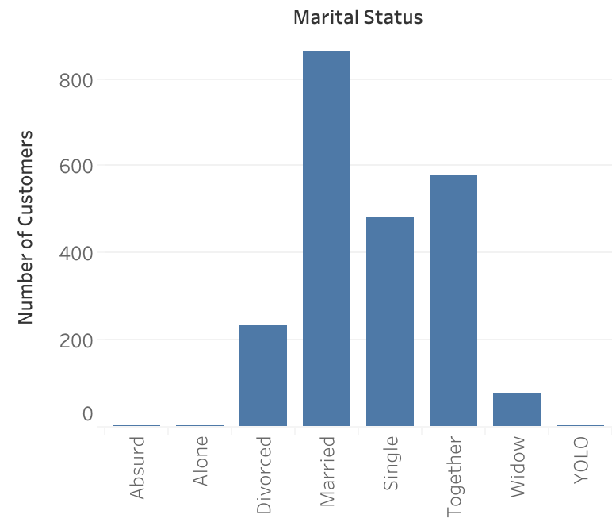
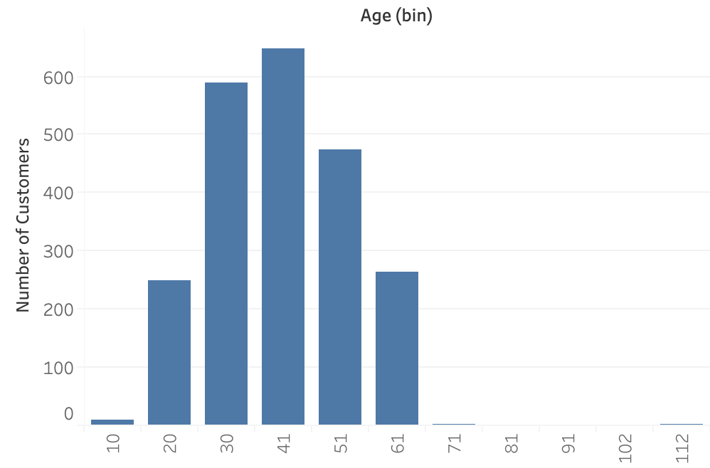
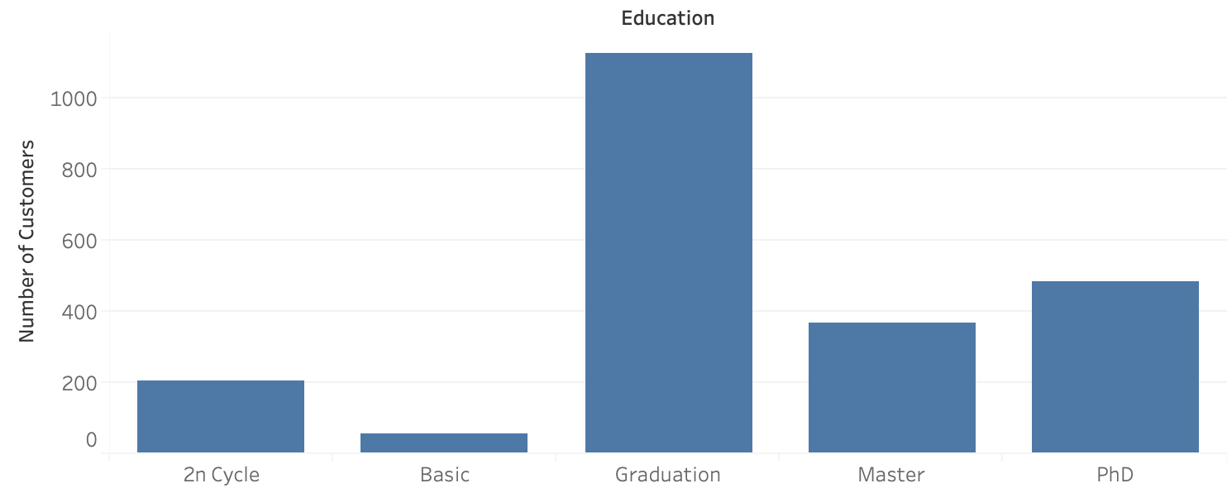
Univariate Analysis - Customer Profile
Ambiguous levels – “Absurd,” “Alone,” and “YOLO” – are dropped in the cleaning step.
Notes:
Speaker 3: Ziyang

Slide 10
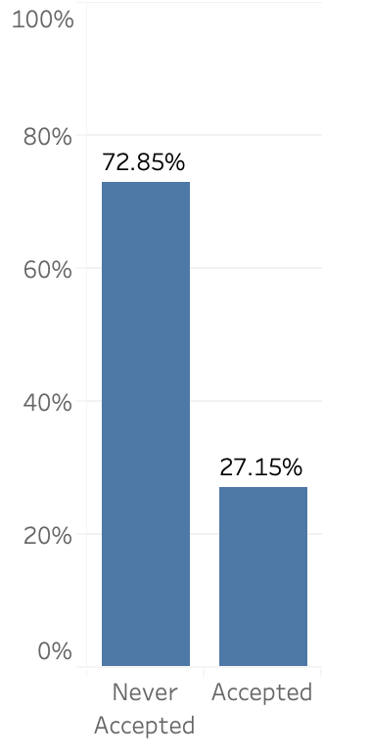
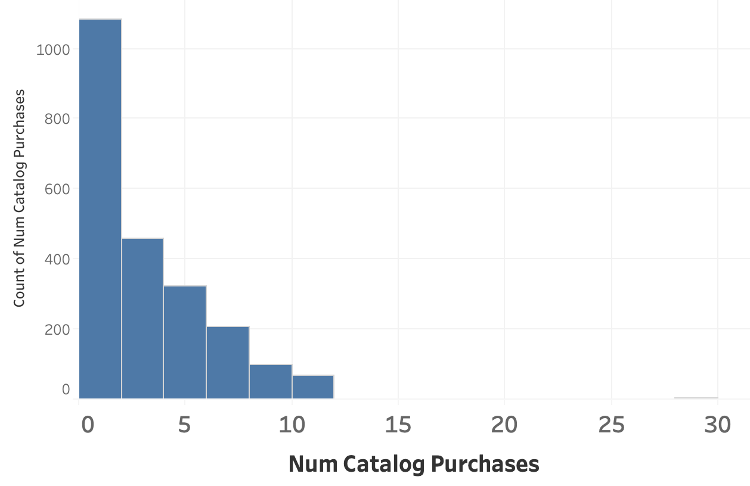
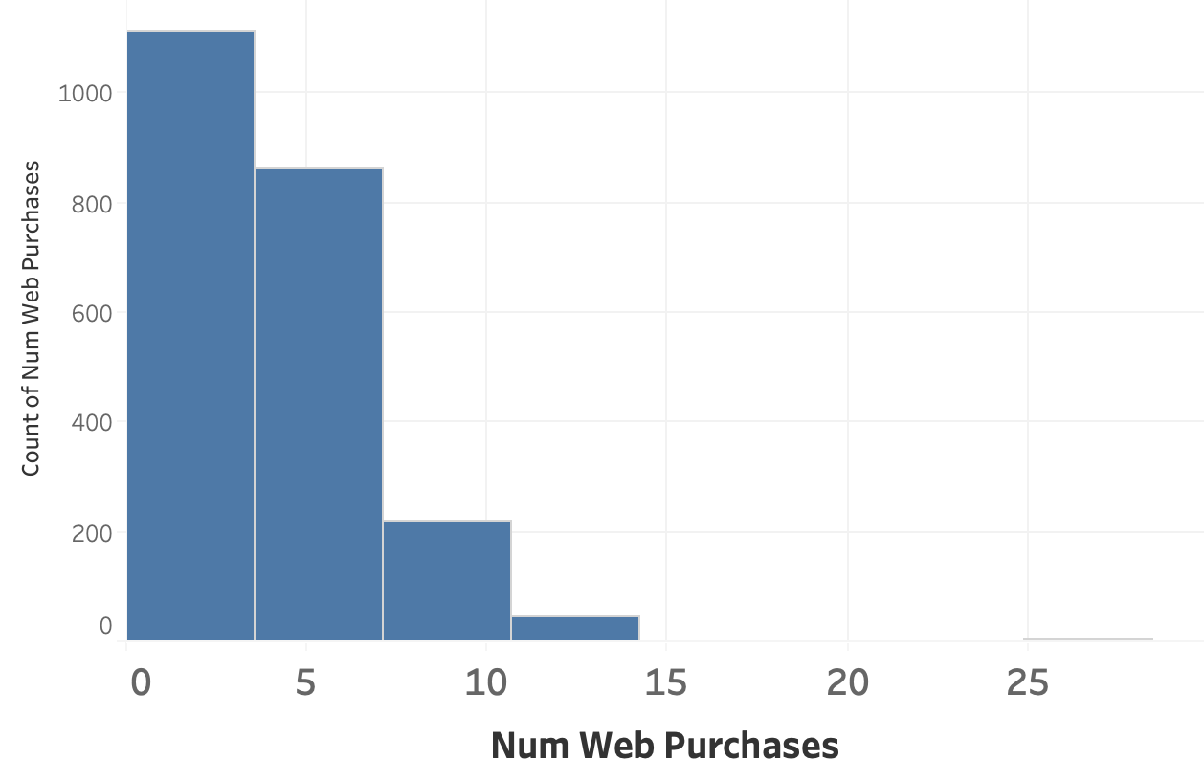
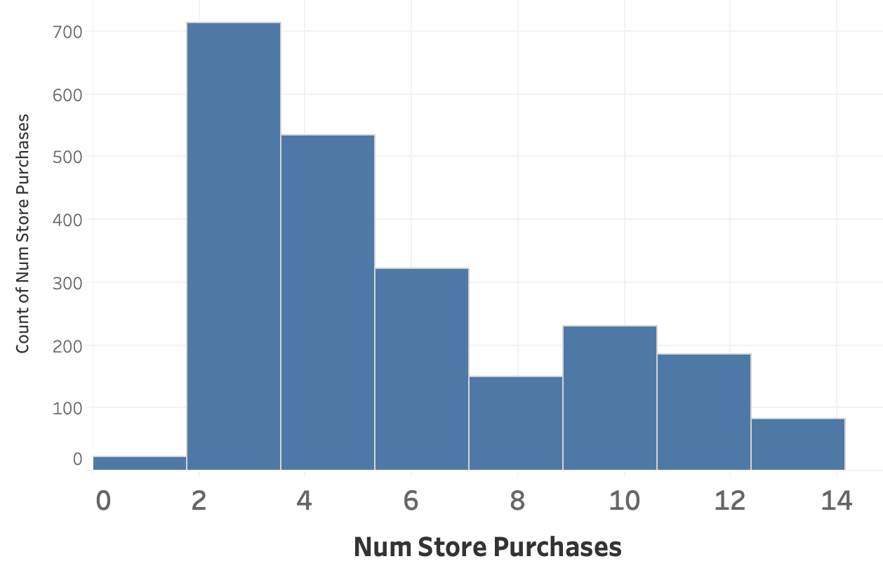
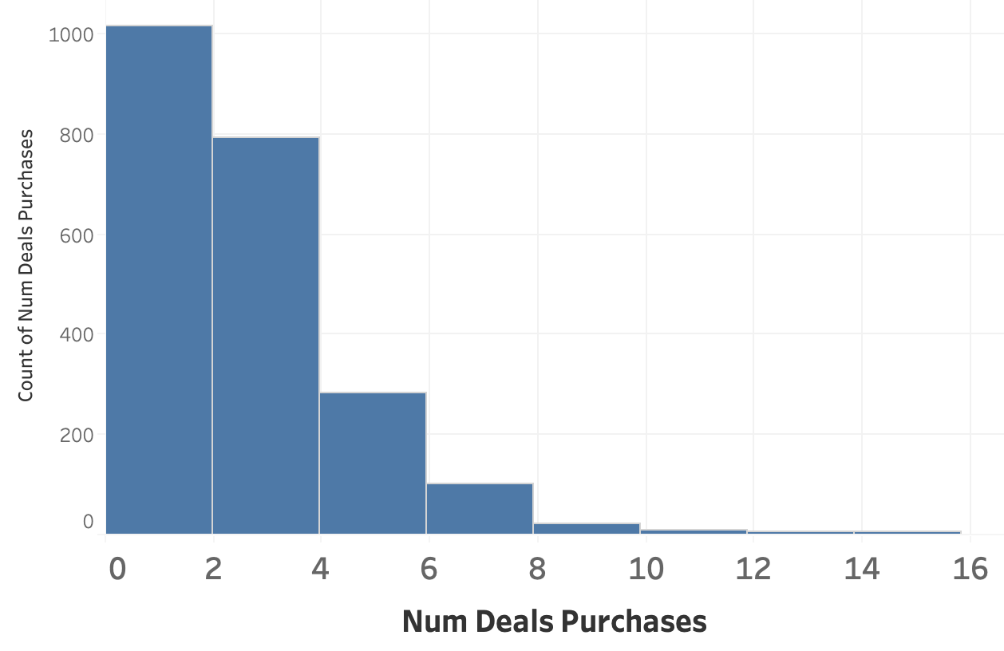
Univariate Analysis - Customer Response
Distribution of number of purchases
27% of customers have responded to at least one of the company’s campaigns.
Notes:
Speaker 3:Ziyang

Slide 11
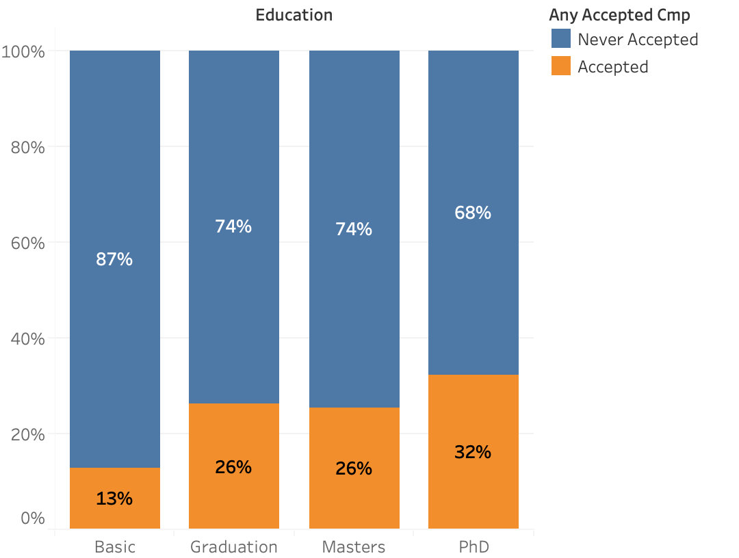
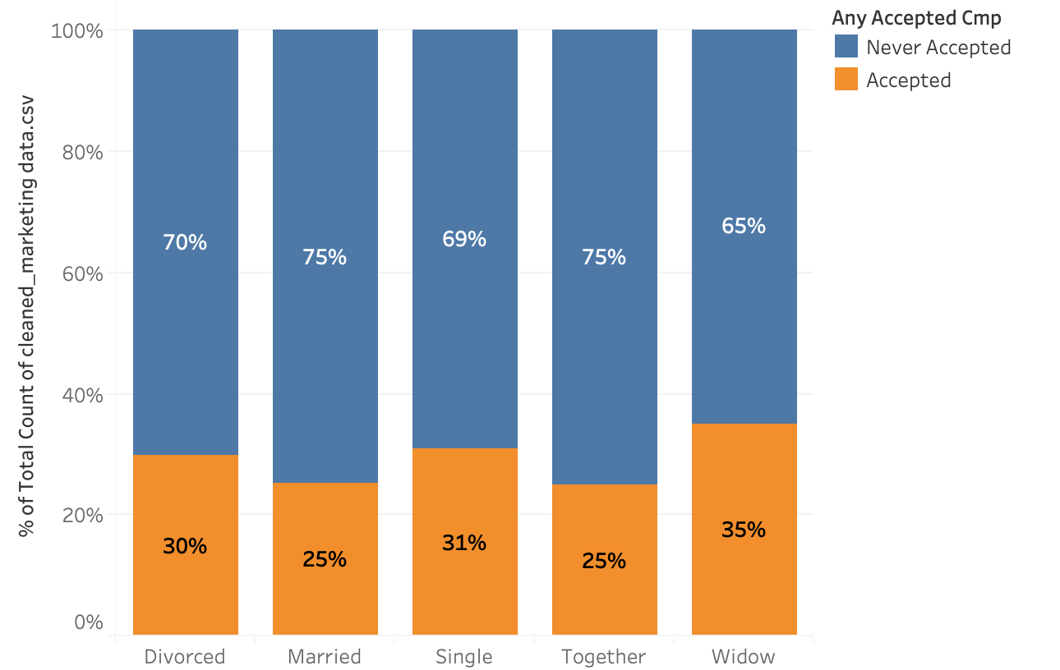
Bivariate Analysis - How predictors correlate with the response
Higher education is associated with more engagement.
Marital status does not have much influence on campaign response.
Notes:
Speaker 3: Ziyang

Slide 12
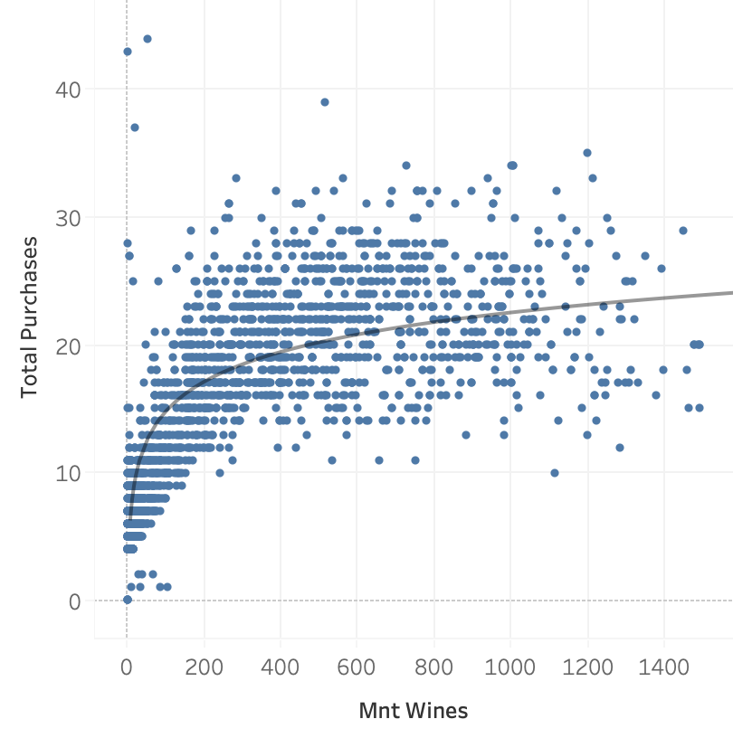
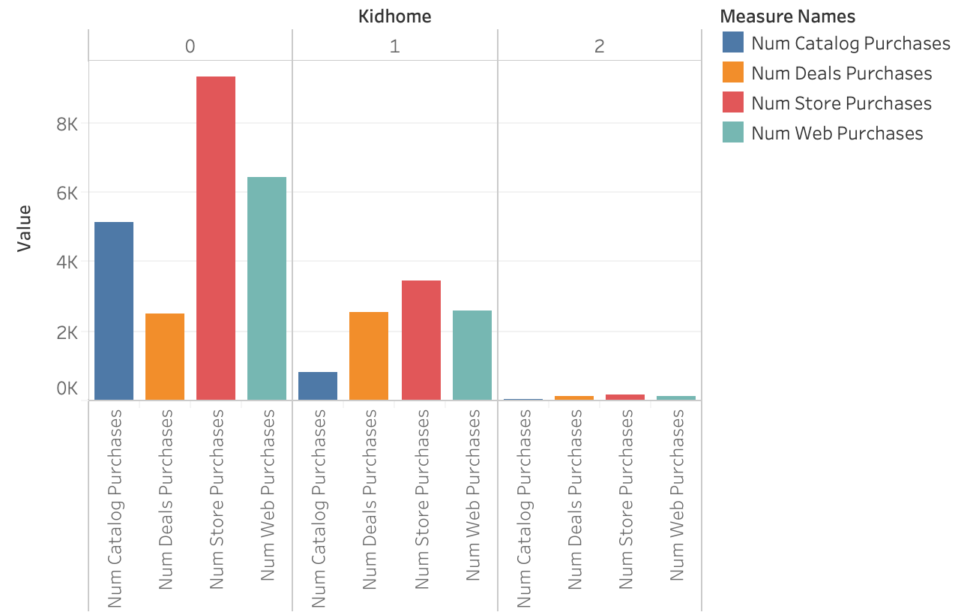
Bivariate Analysis - How predictors correlate with the response
Homes with no kid tend to purchase more through all channels except deals.
Wine consumption is correlated with total number of purchase – possibly warrant a log transformation.
Notes:
Speaker 4: Sean
Here is a Bivariate analysis of predictors to responses. The number of kids appear to be negatively correlated to spending habits. Homes with no kids purchase more than homes with kids. On the second graph, wine is positively correlated to total number of purchase.

Slide 13
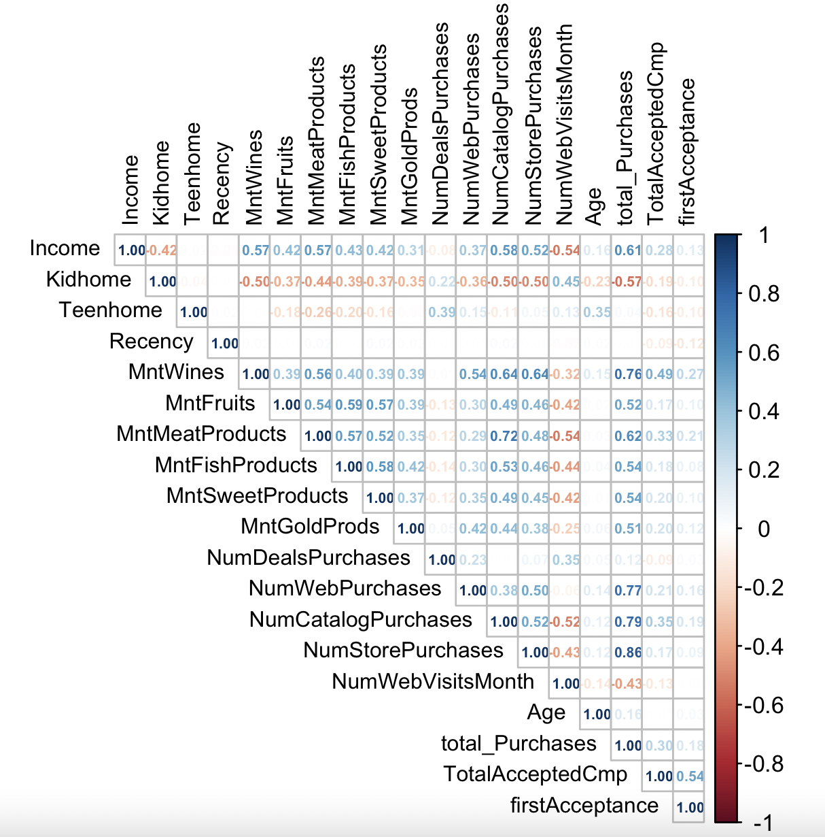
Bivariate Analysis - How predictors correlate with each other
Leaving out the expected dependency of total_Purchases on individual purchase variables, we found the top correlated pairs as listed in the table below.
total_Purchases | MntWines | 0.76
NumCatalogPurchases | MntMeatProducts | 0.72
NumStorePurchases | MntWines | 0.64
NumCatalogPurchases | MntWines | 0.64
total_Purchases | Income | 0.61
total_Purchases | Kidhome | -0.57
It seems that wine consumption is positively correlated with both purchase amount and number of accepted campaigns (0.49).
Consumers tend to purchase meat through catalog and wine using both store and catalog.
Unsurprisingly, more income is associated with more purchases.
It is interesting to note that Kidhome and NumWebVisitsMonth seem to be suppressing factors on all the other numerical variables.
Notes:
Looking at the correlation matrix, we ranked the pair of variables by the strength of their correlation. We found that wine consumption is positively correlated with both purchase amount and number of accepted campaigns.
Also, it seems like consumers tend to purchase meat through catalog and wine using both store and catalog.

Slide 14
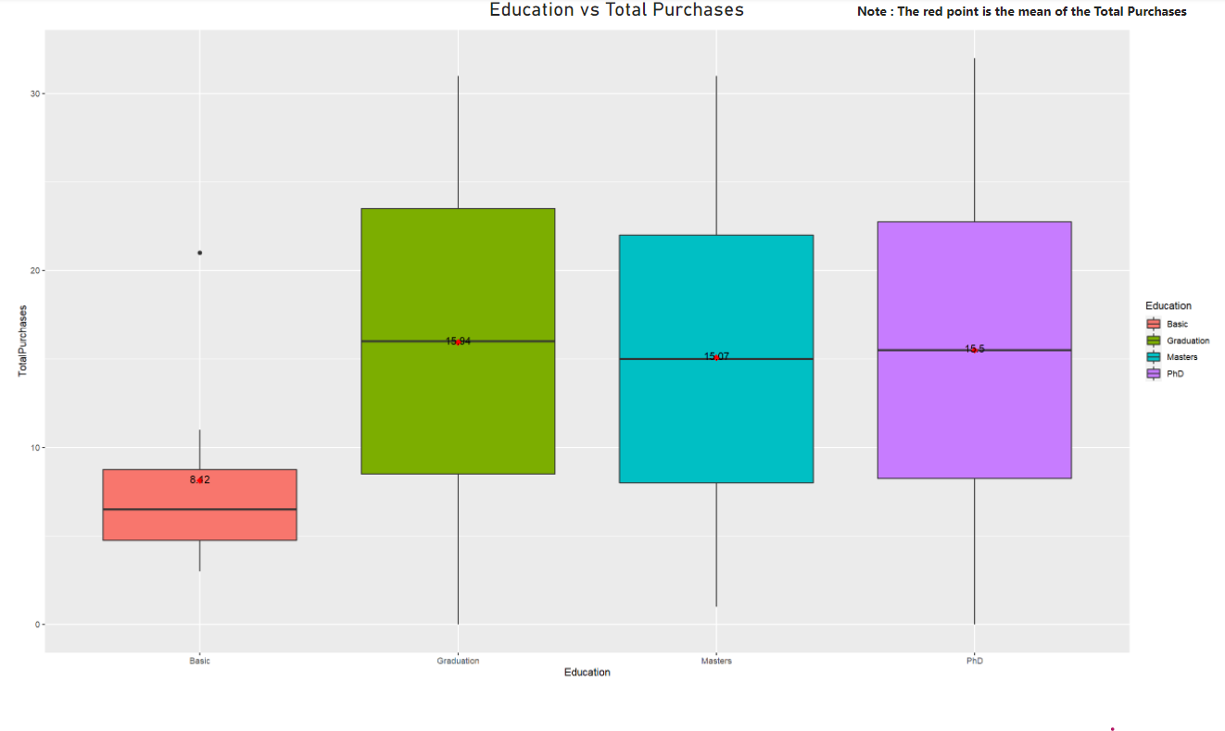
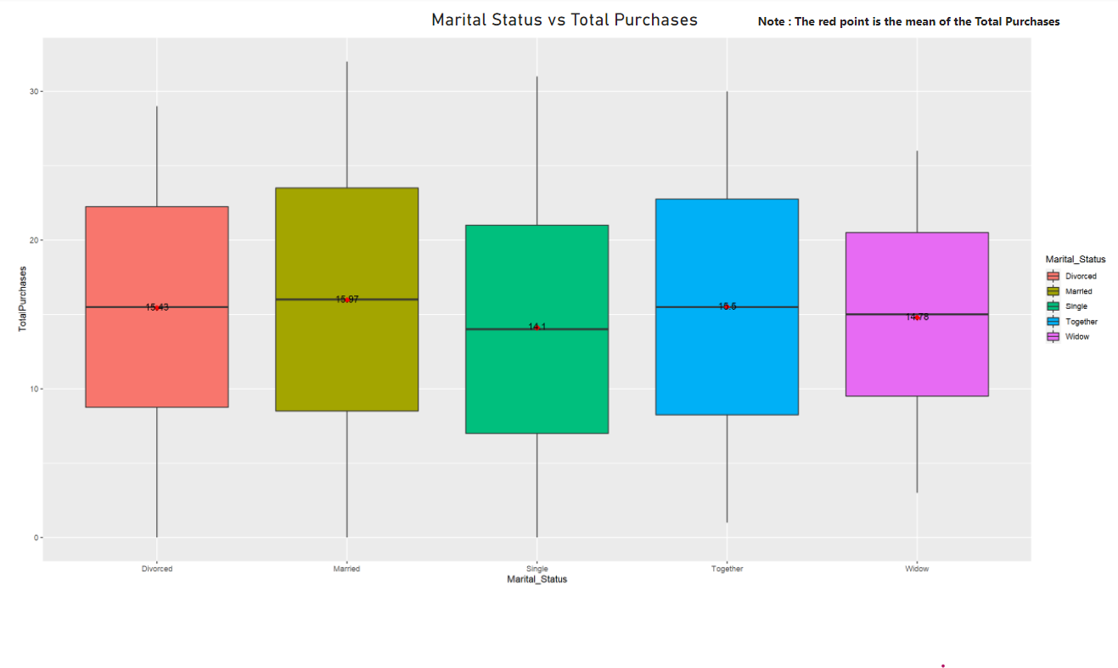
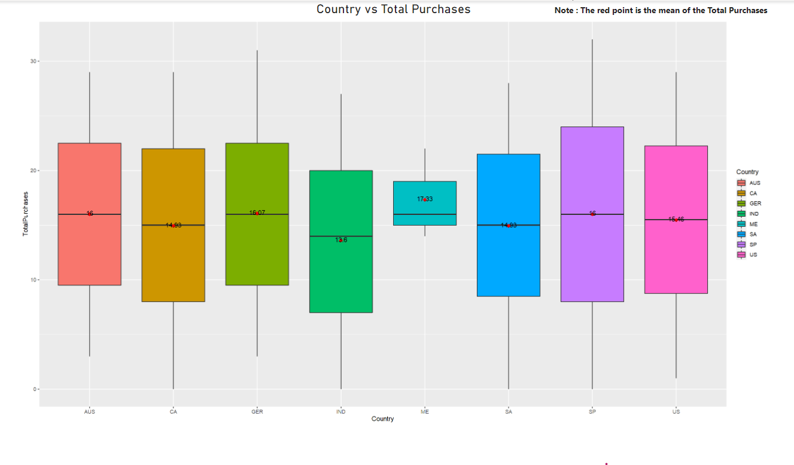
Boxplots of Education/Marital Status/Country vs Total Purchases after Standardization
Notes:
Note : The red point in three plots is the mean of the Total Purchases

Slide 15
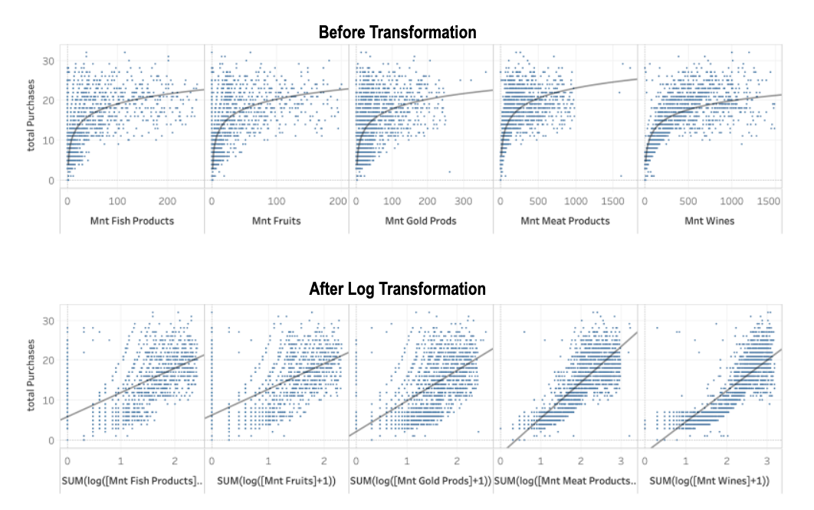
Log Transformation of Data
Notes:
Speaker: Sean
Before we fully dove into a Regression model, we first wanted to see the correlation between individual products to the overall purchases. As shown, each of the products have a non-linear relationship to the total purchases. After natural log transformation, the R2 of each of the trend lines was improved by at least 10%. And the adjusted R2 of the model increased from 0.7724 to 0.8029

Slide 16
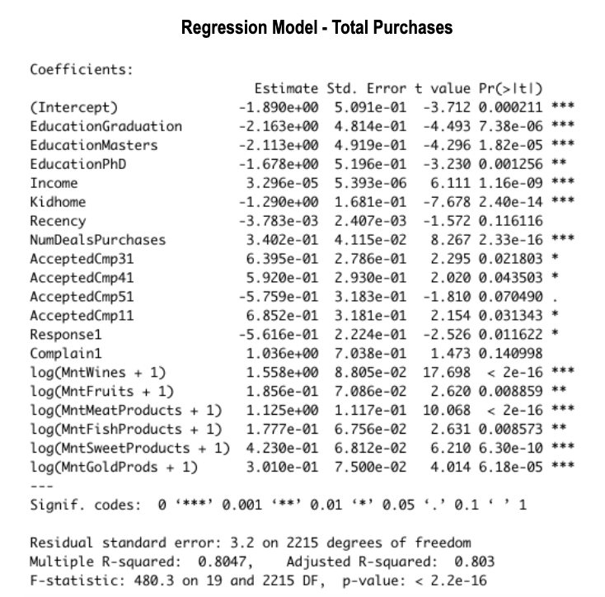
Notes:
Speaker: Sean
Looking at the regression model for Total Purchases, we have an Adjusted R-squared value of 0.803, with significant variables: Education Graduation, Education Masters, Education PhD, Income, Kidhome, NumDealsPurchases, log( Amount Wines), log (Amount Meat Products), log (Amount Sweet Products), and log (Amount Gold Products)
We can observe that higher education and having more kids are associated with lower purchase; an increase of $10K in income would result in 0.3296 increase in purchase on average; accepting 10 more deals is expected to lead to 3.402 more purchases; buying more food and gold have positive effect on purchase as well. Buying wine has the strongest positive effect – 1% increase in wine consumption could result in 1.558 more purchases overall.

Slide 17
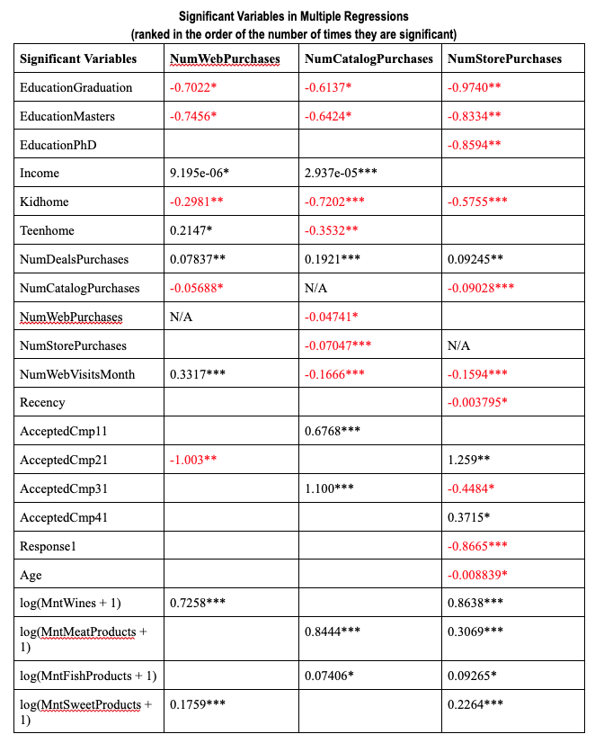
Notes:
Speaker: Sean
It turned out that these independent variables didn’t do as good a job at predicting channel-specific purchases, resulting in a much lower R^2 value. It is interesting to note that the three channels seem to have a negative and competitive relationship against each other. For example, more store or web purchases lead to lower catalog purchases. This indicates that it serves to benefit the business to focus on 1 specific means of advertising

Slide 18
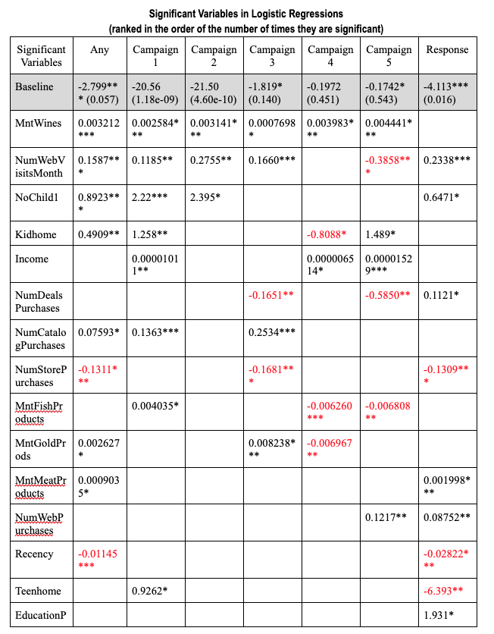
Notes:
Speaker: Sean
This Regression model is for all the advertising campaigns and if customers had accepted those campaigns. Interestingly, Income is a highly significant variable for Campaign 1, 4, and 5. Wine proved to be a significant variable in all of the campaign acceptances.

Slide 19
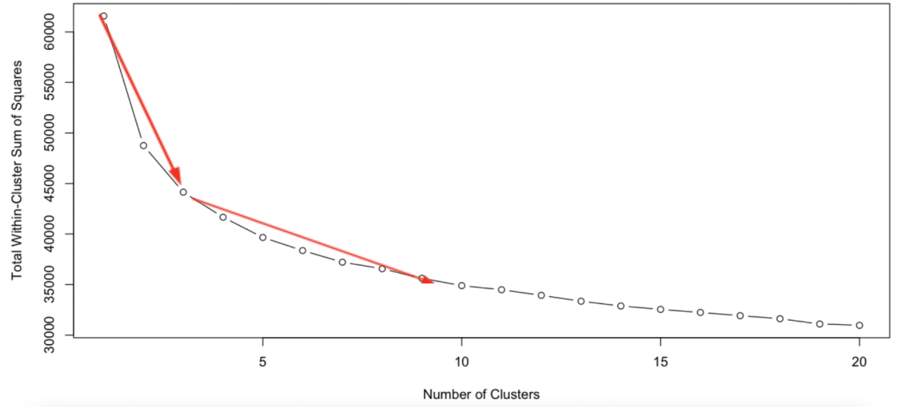
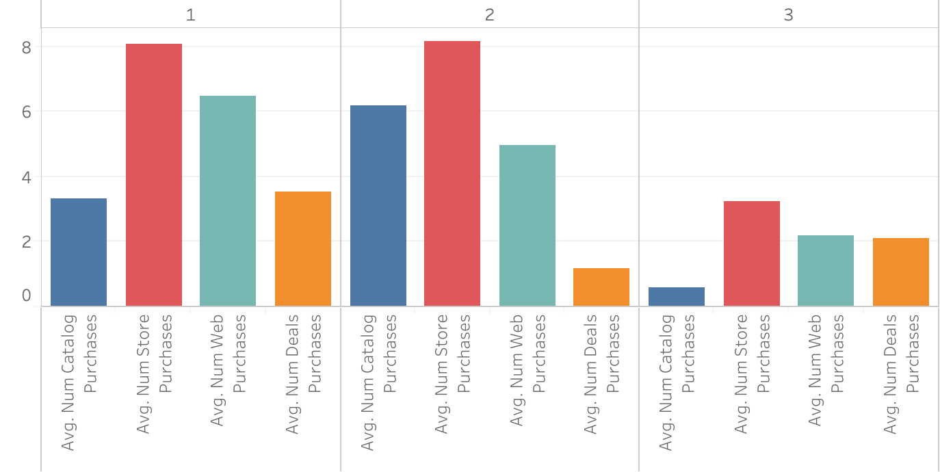
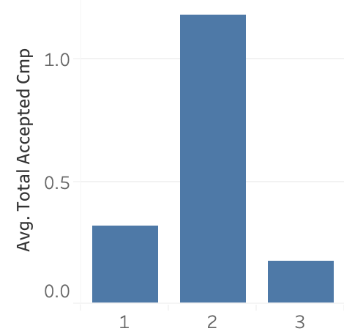
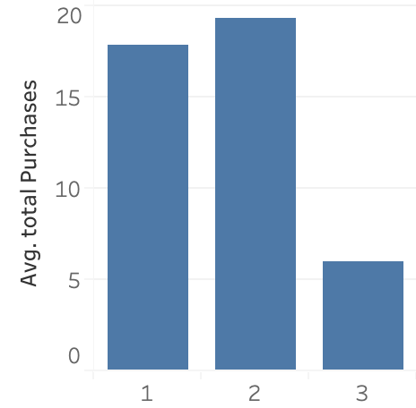
Clusters
Cluster 3: Low value: Is married, in their early 40s, has more than one child, earns the least income among the three, sometimes complains, rarely makes purchases with the company, with deals occupying a large proportion of their overall purchases.
Cluster 1: Moderate value: Is married, in their late 40s, has 1 child, relatively well-off, sometimes complains, likes to purchase wine and sometimes meat from the company, prefers store purchases most and web second, and likes to take deals.
Cluster 2: High value: In their mid-40s, has no child, wealthiest among the three, rarely complains, likes to purchase both wine and meat, prefers store purchases most and catalog second, and takes few deals.
Notes:
Speaker: Tianhua
Since we have a mixture of numeric and categorical variables, we used K-Prototypes algorithm to segment the customers.
From the elbow chart plotting the total within-cluster sum of squares against the number of clusters, we decided to use the three-cluster solution.
The two clusters that have the highest profit margins are Cluster 1 and 2.
Based on these cluster demographics, we would recommend the company to build a loyalty program for cluster 1 that offers family and bulk purchase discounts. For cluster 2, which contains the most valuable customers, we should strive to retain these customers by offering deals in their favorite categories – meat and wine, and at the same time to run campaigns that encourage them to spend in the other food categories.
For future acquisition, finding similar customers that fit cluster 2’s profile would be the priority.

Slide 20
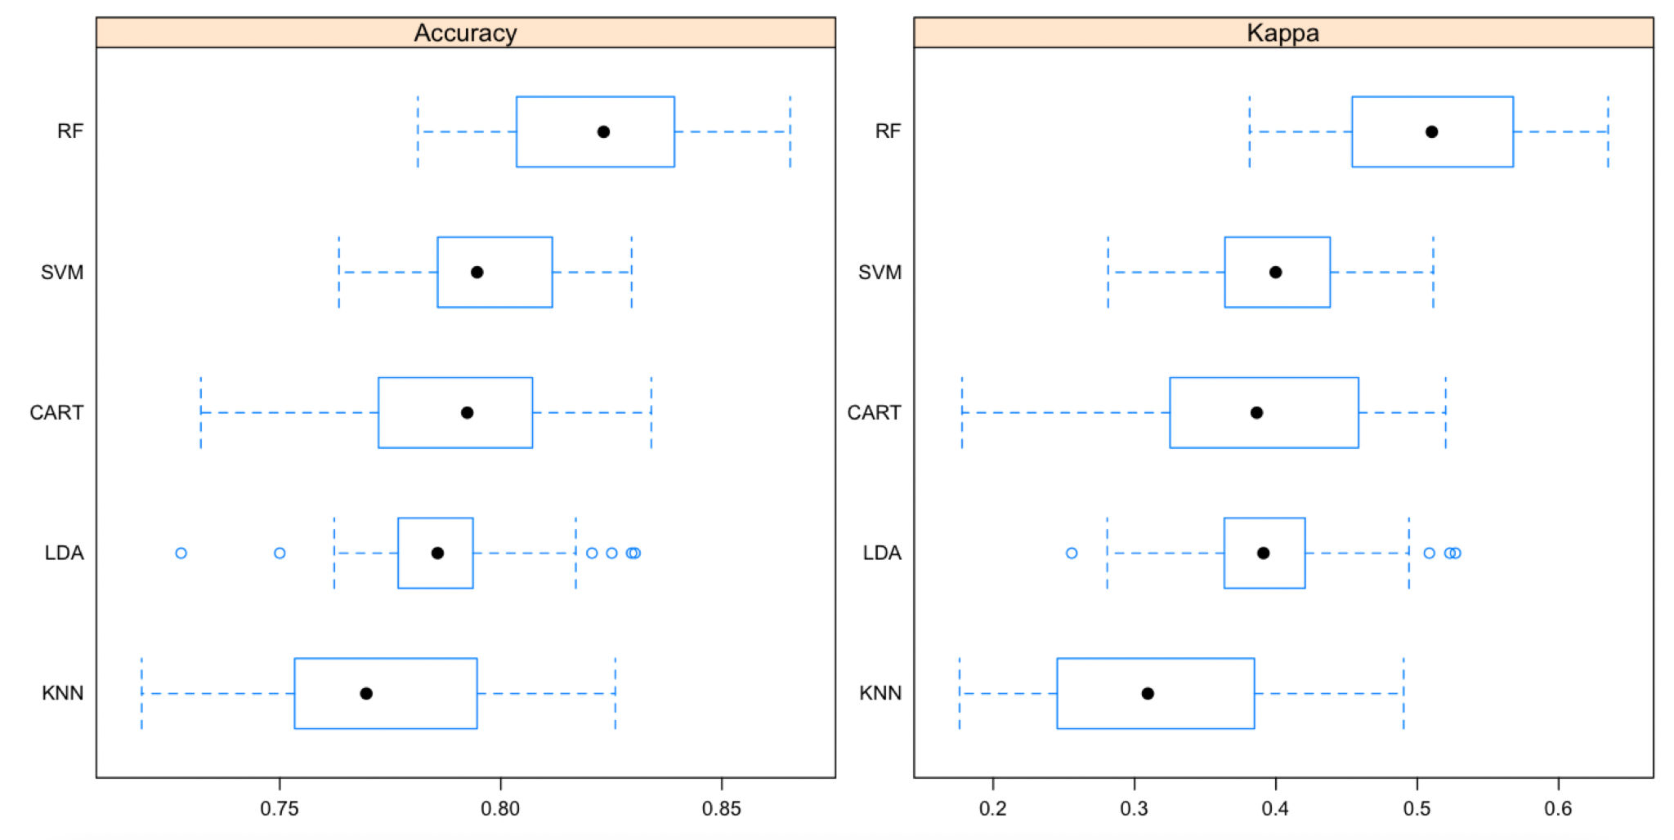
Classification Models
Notes:
Speaker: Tianhua
Another objective of this project is to provide the company with a model to predict future campaign acceptance. Using acceptance of any campaign as the dependent variable, we employed the same predictors and 10-fold cross validation to compare the performance of a set of classification models. With a mean accuracy rate of 0.82, the Random Forest model performed the best.

Slide 21
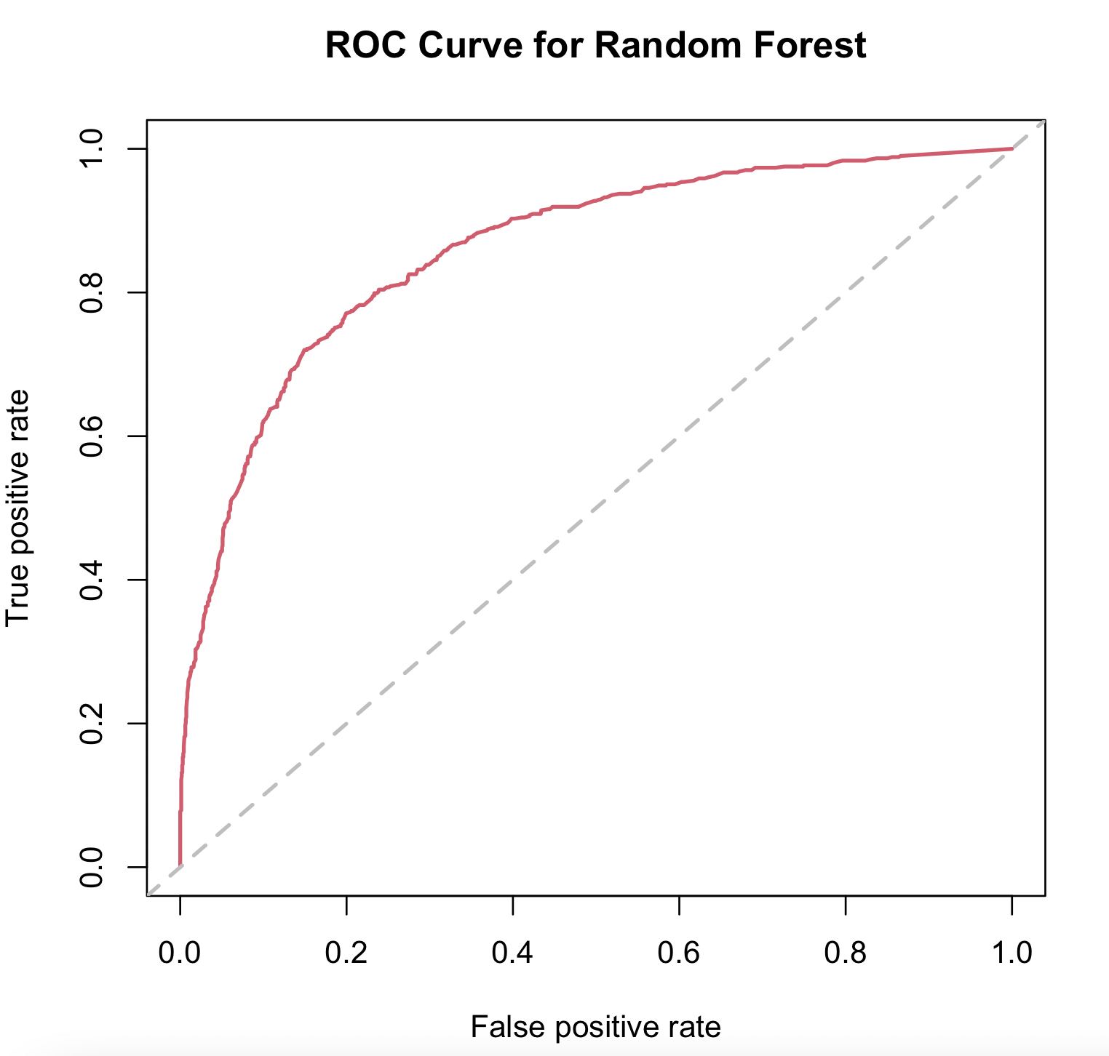
Random Forest ROC
Random Forest | Predicted Negative | Predicted Positive
Actual Negative | 1517 | 112
Actual Positive | 281 | 326
Notes:
Speaker: Tianhua
We ran our winner model Random Forest again with 100 trees. We observed an out-of-bag error rate of 18% and a satisfying AUC of 0.86.

Slide 22
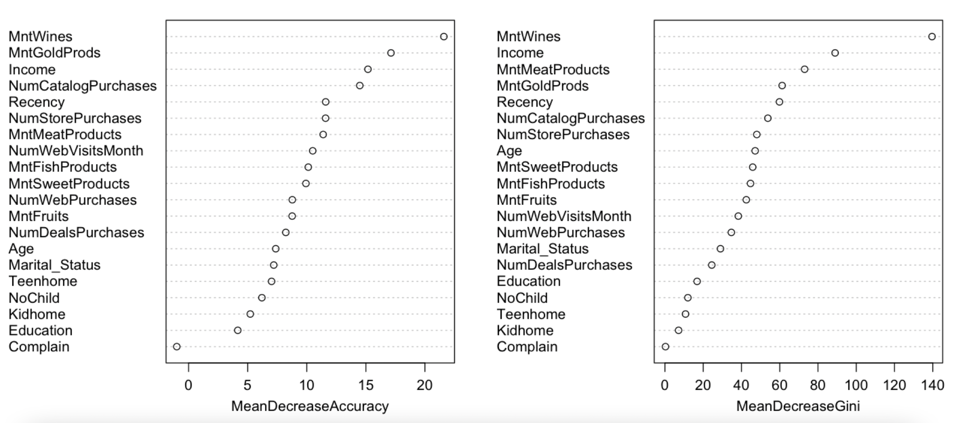
Notes:
Speaker: Tianhua
A benefit of the random forest model is that it can help assess the importance of variables.
As another confirmation of the other findings we’ve discussed, income, recency, purchase of wine, gold and meat, as well as catalog and store purchases prove to be the most important.

Slide 23
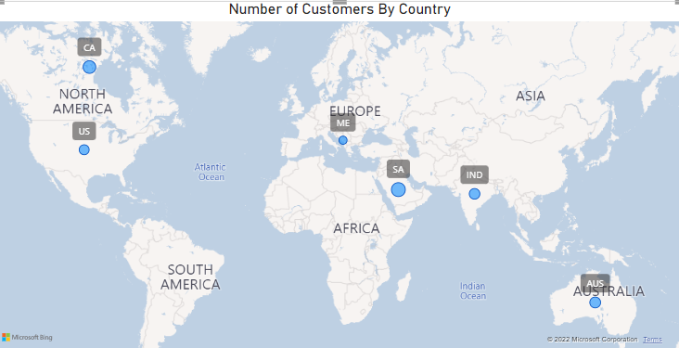
Notes:
Speaker: Bill

Slide 24
2nd Dataset from www.worlddata.com
Country | Code | Mean Income 2012 | Mean Income 2013 | Mean Income 2014 | Mean Income from dataset
Canada | CA | $42,991.14 | $43,034.90 | $41,604.75 | $53,050.62
Australia | AUS | $53,474.85 | $53,920.04 | $48,738.75 | $51,804.29
India | IND | $1,249.08 | $1,249.52 | $1,368.60 | $49,016.41
Montenegro | ME | $5,775.26 | $6,348.01 | $6,475.53 | $57,680.33
Saudi Arabia | SA | $19,659.59 | $19,473.33 | $19,536.13 | $54,830.82
United States | US | $44,727.36 | $45,665.51 | $47,701.37 | $53,218.37
Notes:
Speaker: Bill

Slide 25
Business Recommendations
Customer acquisition:
Improve store front presentation and customer service as stores are the most profitable channel
Make offers of wine and meat to those who fit the most valuable customer profile to encourage them to buy more
Campaign engagement:
Push campaigns digitally to those who are more savvy on the Internet
Run a widenet campaign and focus on building up the momentum using follow-up targeted campaigns as previous campaign acceptance influences the future
Predict likelihood of campaign acceptance via the trained Random Forest model and focus resources on the potentials
Notes:
Speaker: Vakula
Based on our models and analysis, here are our recommendations to the company. For customer acquisition, we would recommend them to improve their storefront presentation and customer service since stores are the most profitable channel. The company should make more offers of wine and meat to those who fit the most valuable customer profile to encourage them to buy more. For campaign engagement, we would recommend to push the campaigns digitally for more tech-savvy customers. The company should also run a widenet campaign and use follow-up targeted campaigns to build up momentum. We predict the likelihood of the campaign acceptance via the trained Random Forest Model and would recommend the company focus resources on the potentials.

Slide 26
Further Analysis
Unknown Campaigns details
Such as campaign strategy, creatives, messages
More store level data and company information
i.e. Specialty store, basic general goods
Further regression analysis
Notes:
Speaker: Vakula
For further analysis, we would need to get more campaign details from the company such their campaign strategy, creatives and messages in the campaigns. We would also like more about the company and about its stores such as the type of store it is and their store sizes. We would also do further regression analysis based on the cluster model should the company choose to follow our analysis.

Slide 27
Thank you!

